Slide 1
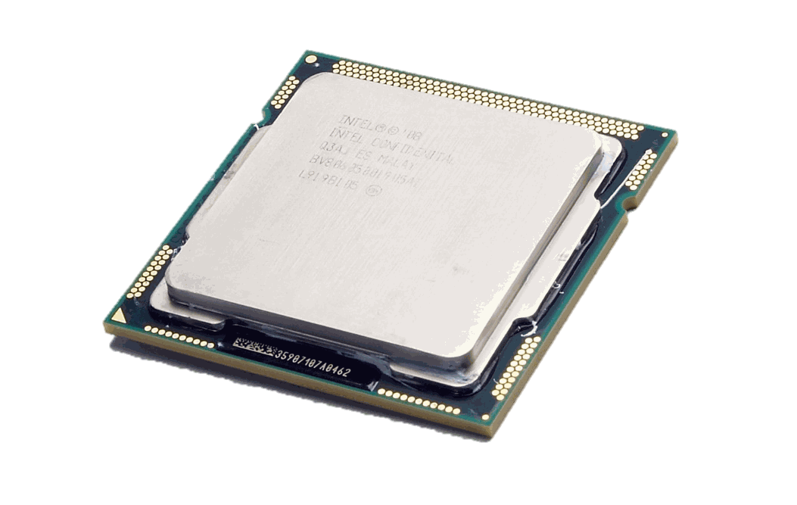
Computer Hardware
Digital Technology | Chapter 5

Slide 2
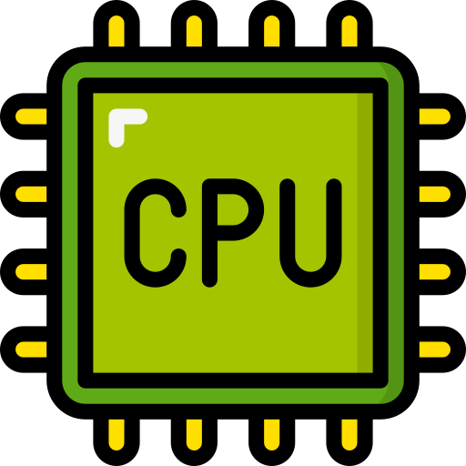
The CPU
This is known as ‘the brain’ of the computer
It is a microprocessor, and its main role is to process programs and data
This is achieved by repeatedly fetching an instruction from memory and executing it (carrying out the instruction)
This is known as the fetch-execute cycle
explain the purpose of the central processing unit (CPU)
📖 CPU Purpose
Manages the functions of a computer by processing data and instructions; carries out the instructions of a computer’s programs.

Slide 3
The CPU
A computer appears to be completing many tasks at once for example playing music while you complete homework or surf the internet. However, the CPU is only completing one task at a time.
The central processing unit uses a quartz clock to control how much time is given to each task.
With each tick of this clock, the CPU processes one piece of data or executes one instruction for a particular task.
explain the purpose of the central processing unit (CPU)
📖 CPU Purpose
Manages the functions of a computer by processing data and instructions; carries out the instructions of a computer’s programs.

Slide 4
The CPU
The CPU has some very important components:
📖 The Arithmetic Logic Unit (ALU)
The ALU processes all data inside the CPU. Arithmetic logic unit: the part of the CPU that carries out arithmetic calculations and logical operations and comparisons, e.g. AND, OR, NOT and 'greater than'.
Control Unit
Arithmetic Logic Unit
📖 The Control Unit
The part of the CPU that fetches and decodes instructions and sends control signals so that they are executed, co-ordinating all the other components of the computer.
Immediate Access Store
Registers are normally used for a specific purpose, where data or control information is temporarily stored. Some registers are used in the fetch-execute cycle while others may be used by the program being executed.
Registers are much faster to access because they have to be accessed so often.
📖 The Immediate Access Store
Each piece of data is stored in the RAM chip so that the CPU can retrieve data immediately. Main memory that holds the programs and data currently in use. Each memory location has a unique address assigned to it.

Slide 5
REGISTERS: Program Counter
This stores the address (memory location reference) of the next instruction to be fetched
Many program instructions are ordered, the program counter is incremented by 1 each time an instruction is fetched.
The program counter always points to the next instruction address in sequence.
📖 Program Counter
The register that holds the address of the next instruction to be fetched; it is incremented after each fetch.
Processing…
00000006
00000004
00000005
00000001
00000002
00000003
📖 Register A very small, fast memory location inside the CPU used for one specific purpose

Slide 6
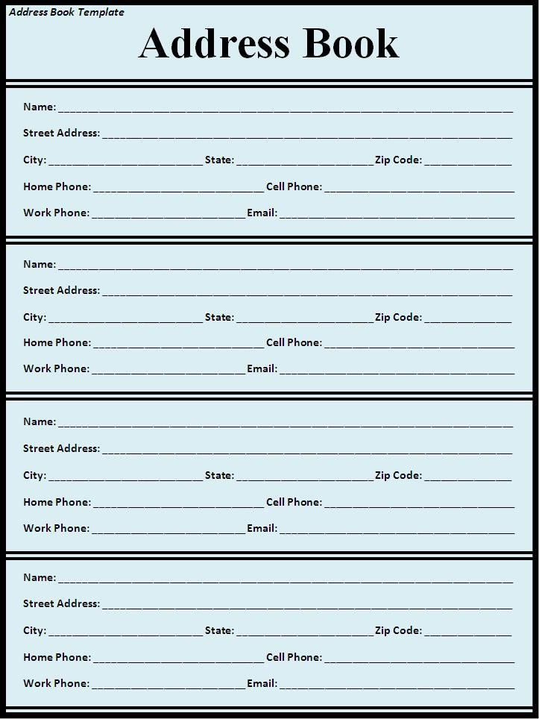
REGISTERS: Memory Address Register
📖 Memory Address Register
The memory address register stores the memory location which is being used (read from/written to) by the current instruction.
Also called MAR
All program instructions are stored in a number of memory locations, each of which have a unique address
The current instructions’ address is stored (temporarily) in the MAR
📖 Register A very small, fast memory location inside the CPU used for one specific purpose

Slide 7
REGISTERS: Memory Data Register
📖 Memory Data Register
Holds the data or instruction being transferred to or from memory; everything moving between the CPU and memory passes through it.
CPU
Temporarily stores data being fetched from/written to the main memory of the CPU
This is the only register that is directly linked between RAM (main memory) and the CPU.
Any data being sent into the CPU goes into this register
MDR
Data
Main Memory
(RAM)
📖 Register A very small, fast memory location inside the CPU used for one specific purpose

Slide 8
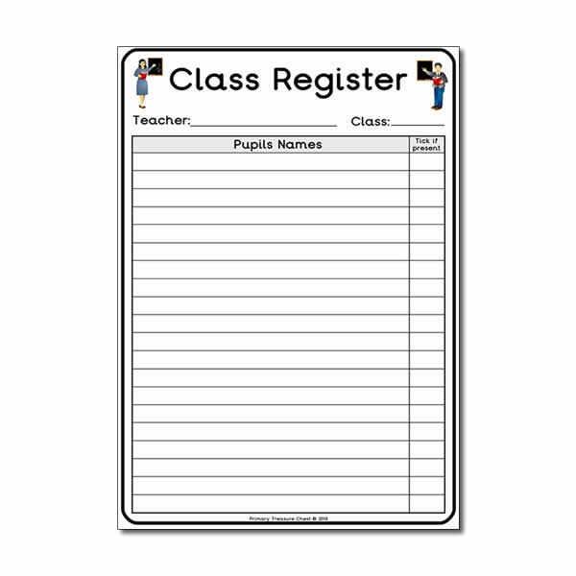
REGISTERS: Instruction Register
📖 Memory Data Register
AKA Current Instruction Register. It holds the instruction currently being decoded and executed.
Instruction Register
Temporarily stores the current instruction to be decoded and then executed, having already been fetched from the main memory.
Current Instruction ✔
📖 Register A very small, fast memory location inside the CPU used for one specific purpose

Slide 9
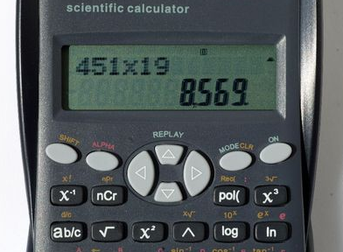
REGISTERS: Accumulator
Part of the ALU
When calculations take place on data, the results are initially stored in the accumulator before being transferred and stored in the main memory.
Default location to store any calculations performed by the ALU (Arithmetic and Logic Unit)
📖 Accumulator
A register in the ALU that holds the result of a calculation before it is stored in memory.
📖 Register A very small, fast memory location inside the CPU used for one specific purpose

Slide 10

Factors affecting the speed of processing
The CPU clock speed is measured in cycles per second. 1 cycle per second = 1 Hertz. A typical desktop computer is extremely quick, running at 3 billion times per second or 3GHz.
It is this speed that makes it look as though the computer is completing multiple tasks at once.
The faster the clock speed of a computer the more powerful the computer is, the quicker the central processing unit will work.
FACTOR #1: Clock Speed

Slide 11
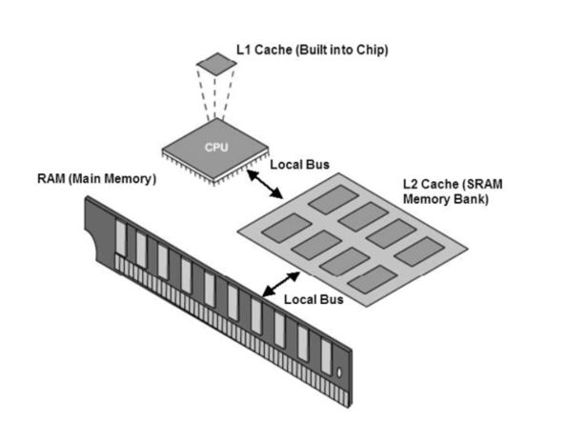
Factors affecting the speed of processing
Cache memory has extremely fast access, with small capacity.
The Control Unit automatically checks the cache memory first when fetching an instruction.
Even faster than checking RAM.
The use of cache memory can greatly reduce processing time therefore the greater the Cache size the quicker the processing time.
📖 Cache Size
A small amount of very fast memory inside or next to the CPU that holds frequently used instructions and data, so they need not be fetched from slower RAM.
FACTOR #2: Cache Size

Slide 12
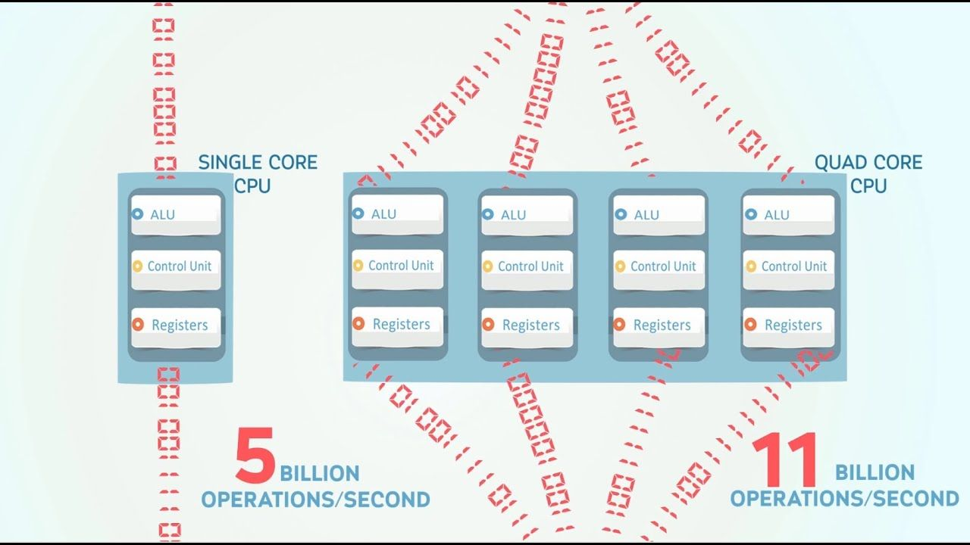
Factors affecting the speed of processing
Modern computers speed up their clock speed/processing power by containing more than one processor. Some companies call these CPU’s ‘core’.
Therefore a ‘dual core’ device means the computer contains 2 processors, a ‘quad core’ device means the computer contains 4 processors.
📖 Processor Core
An independent processing unit inside a CPU with its own control unit, ALU and registers, so it can process instructions at the same time as other cores.
FACTOR #3: Cores

Slide 13

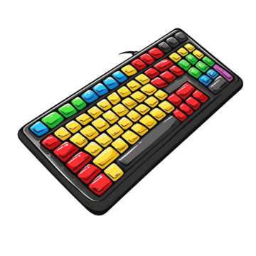


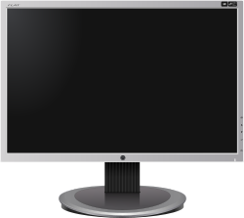
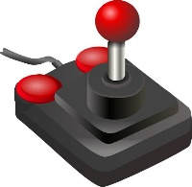

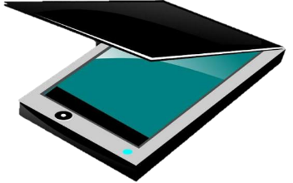
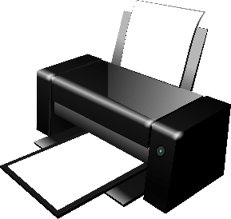
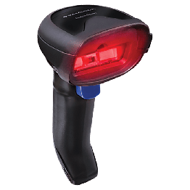
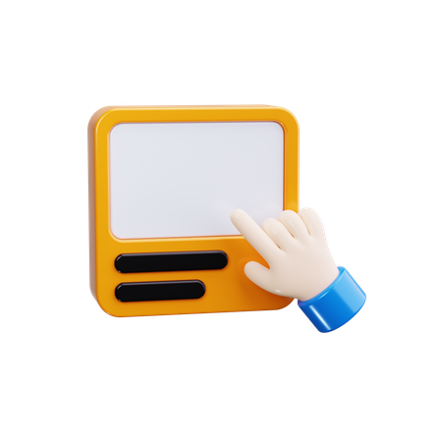
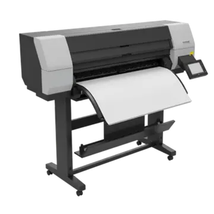

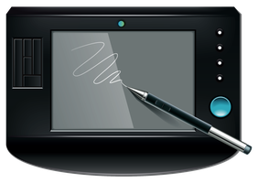

Input
Output
Headphones
Monitor
Inkjet/Laser Printer
Plotter
Speakers
Webcam
Keyboard
Joystick
Scanner
Barcode Scanner
Mouse
Graphics Digitiser
Camera
Headset
Touchscreen

Slide 14

DEVICE #1: Microphone
CHRARACTERISTICS
Input Device
Has a diaphragm, usually made of plastic inside it.
When a sound wave hits it, the diaphragm moves back and forth
Advantages
Allows ease of movement as it is hands-free
Used with voice recognition software
Faster to speak than typing
Disadvantages
Wireless microphones have limited range/battery
Recognition of spoken words can be slow
Sound files are much larger than text
Typical Use
To input sound into a computer
To convert sound waves into digital data
Used during VOIP (Voice over Internet Protocol)

Slide 15
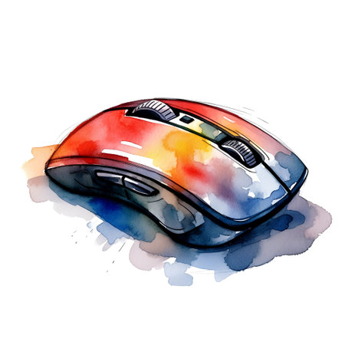
DEVICE #2: Mouse
CHRARACTERISTICS
Input device
Has one or more finger operated buttons
Needs to be on a flat surface to operate
Uses Sensors to detect movement
Advantages
Easy to use, with little-no training required
Highly responsive and accurate
Can be adjusted to suit users needs, with a wide variety available.
Disadvantages
Experienced uses find it slower than ‘hot keys’
Requires a flat surface/additional space to operate
Wireless mice need to be close to the computer
Easily broken
Typical Use
Controls a pointer on a VDU (Visual Display Unit)
Allows a user to navigate a user interface, such as clicking on an icon or menu option on screen

Slide 16
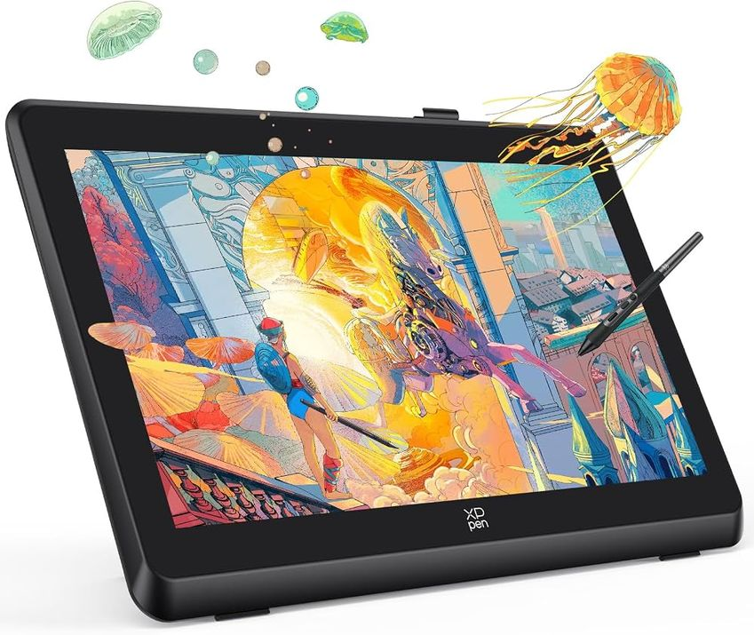
DEVICE #3: Graphics Digitiser
CHRARACTERISTICS
Input device
Consists of a flat surface where you use a stylus to write or draw with.
As you draw on the surface an image will appear on the screen of the connected computer
Advantages
Greater accuracy
Very ‘natural’ way of drawing/writing
Disadvantages
Can be very expensive
Not suitable for selecting menus/pointing at menu items
Typical Use
Often used by graphic designers and illustrators
Can be used to capture hand-written signatures

Slide 17
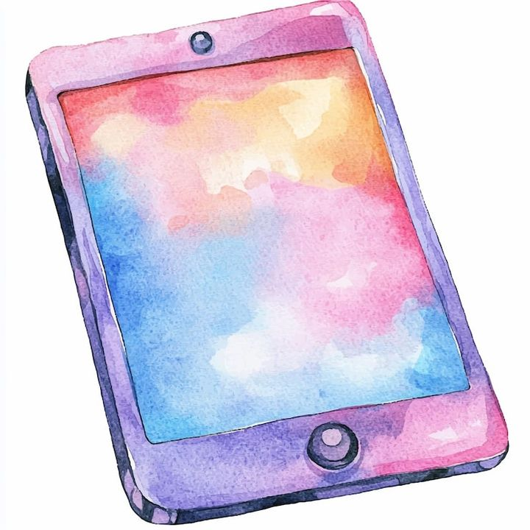
DEVICE #4: Touch Screen
CHRARACTERISTICS
Both an Input & Output device
Works by using your finger to touch the screen.
Touching the screen sends coordinates into the device which are translated into instructions for the device.
The screen can detect the difference between tapping, swiping and pinching actions.
Advantages
Easy to use (intuitive)
Can see all available options
Don’t need excellent ICT skills to use
Can be adapted for many uses
Usually fixed to larger devices so less chance of them being stolen
Disadvantages
User needs to understand the icons used
Limited options available
If damaged the touch screen may not respond
Can be easily scratched, get dirty
Difficult to see in bright sunlight
Typical Use
Mobile phones, tablets and ATMS
Museums and galleries
Paying for tickets in a train station/food outlet

Slide 18
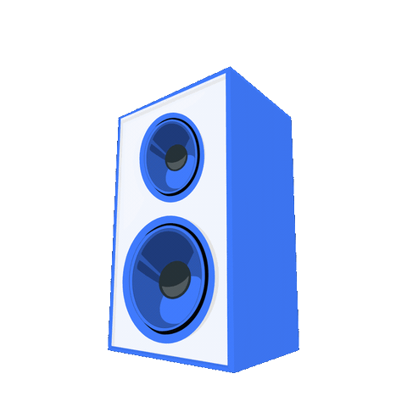
DEVICE #5: Speakers
CHRARACTERISTICS
Output device
Uses audio signals and converts them to sound waves
Most computers have a small internal speaker, but external speakers connect by USB or wirelessly for better quality audio.
Advantages
Very natural way to communicate
Useful for visually impaired users
Disadvantages
External speakers require additional desk space
Speakers can distract other users in the same office
Typical Use
Used for music, video and games
Allows for text-to-speech
Error alerts often use a ‘beep’ from the speaker

Slide 19
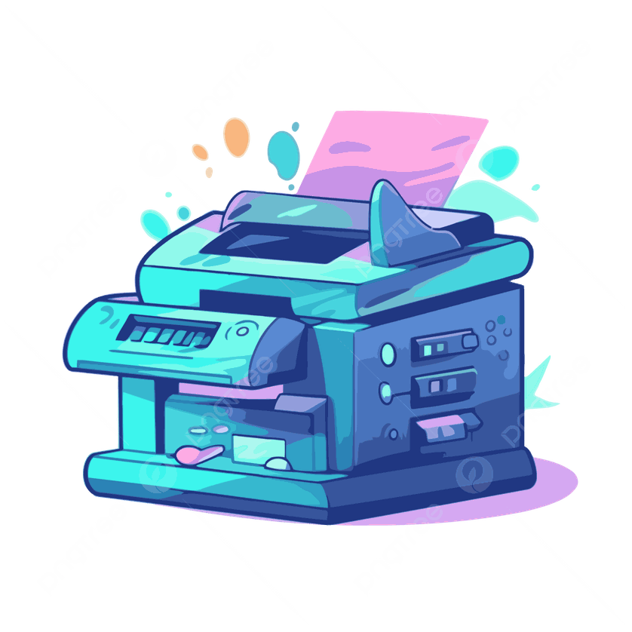
DEVICE #6: Laser Printers
CHRARACTERISTICS
Output device
Uses a laser beam to ‘write’ the image onto a light sensitive drum.
The drum uses electrostatics to attract toner to the image of the drum
Paper is pressed against the drum to transfer the image using heat to seal the toner to the paper
Advantages
Produces high quality prints
Prints very quickly, particularly in bulk
Very quiet
Can get colour laser printouts
Disadvantages
Produces shiny images
More suited to text printing
Can be expensive, and refill toner is expensive to purchase
They are non-impact printers, so multipart stationary cannot be used
Typical Use
Used to print documents at high speed
Notes:
Multipart stationary – letting multiple copies be made simultaneously i.e. letting ink feed through multiple pages at once

Slide 20
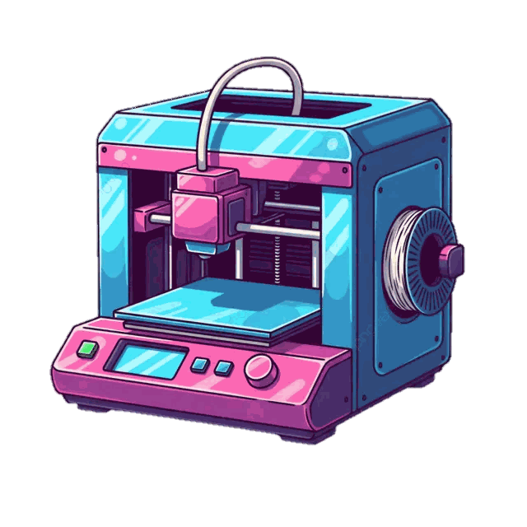
DEVICE #7: 3D Printers
CHRARACTERISTICS
Output device
Usually cube shaped with a transparent ‘door’ that can be opened to remove the finished product.
The product is created in layers by melting its print material through a highly accurate nozzle.
Advantages
Streamlines production and design process
Faster than conventional methods of prototyping
Saves time and money at the initial product development
Wide variety of print materials available
Disadvantages
Equipment very expensive
Price difference between print materials is huge
Limited form of printing – suitable for prototypes nor ‘real’ product
Non economical for large scale printing
Typical Use
Prototyping in the medical, Aerospace, Automotive, Jewellery, and Art Industries
Models and ‘proof of concepts’

Slide 21

DEVICE #8: Hard Disk Drive (HDD)
CHRARACTERISTICS
Storage device
Ridged magnetic disks enclosed in a sealed container. Recording head (read/write) are very close to the magnetic material
Advantages
High recording density / Large storage capacity
Faster than CD/DVD
Cheap per megabyte
Non-volatile storage
Disadvantages
Slower than RAM or ROM
Can crash which stops the computer working
Regular crashes can physically damage the surface.
Typical Use
Stores all programs, software and operating system used by the computer or user

Slide 22
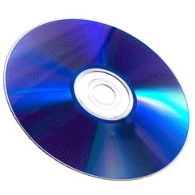
DEVICE #9: High Definition (HD) Storage Media
CHRARACTERISTICS
Storage device
Uses a blue laser (instead of red) which burns much smaller pits onto the surface
Increases density and therefore storage capacity
Blu-ray is an optical disc format used to store high definition video as well as games.
Advantages
Blu-Ray and HDDVD disks work the same way as DVD disks but
can hold more high quality data.
Better picture, better sound than previous optical media
Disadvantages
You need dedicated players.
With so much data it can take time to load a film.
Typical Use
To store large amounts of high quality data, such as films.

Slide 23
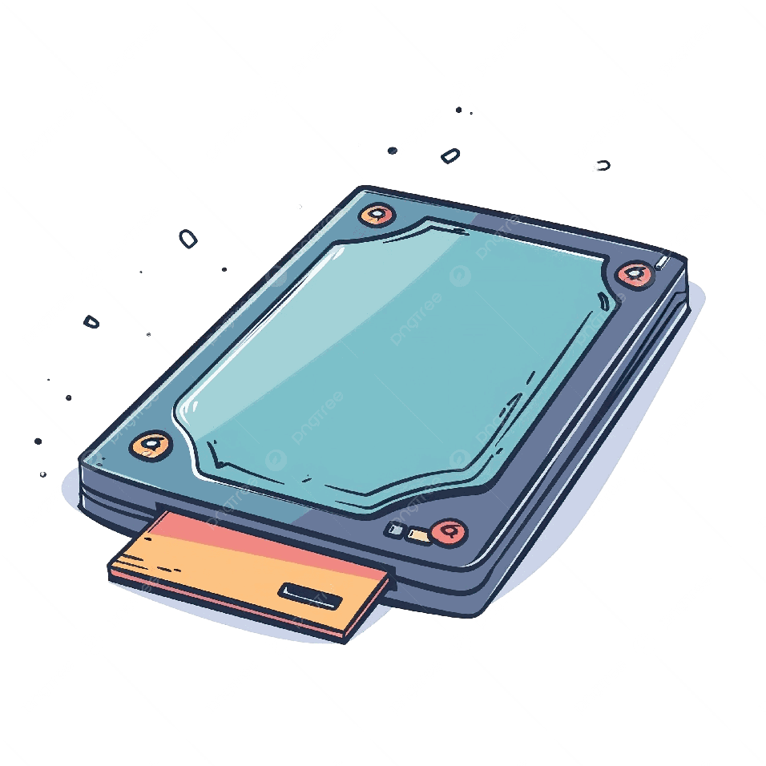
DEVICE #10: Solid State Drive (SSD)
CHRARACTERISTICS
Storage device
A collection of memory chips controlled by its own software. The software makes the chips act like a disk drive.
Non volatile NAND flash memory and has no moving parts
Advantages
Faster start up than HDDs.
Less noise as there are no moving parts
Disk defragmentation is not required.
Less power requirements
Disadvantages
Usually come in smaller capacity than HDDs as the cost per megabyte is higher
Typical Use
In most machines, these are replacing traditional hard disk drives

Slide 24
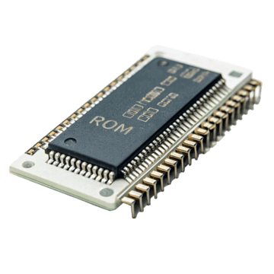
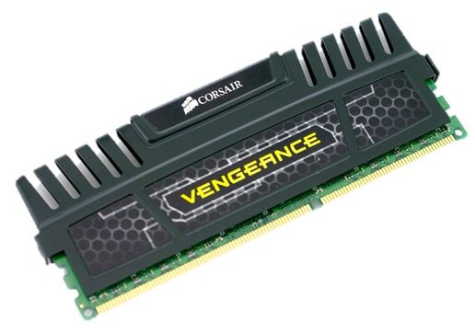
Memory
ROM
RAM
Can be read from, but not written to.
Programs are stored permanently, meaning contents cannot be altered.
Non-volatile
Used to store programs that are frequently required by the computer such as the boot script (what runs when you turn on the computer, loads the OS)
Can be read from or written to.
Is volatile (contents is lost when power is switched off)
Used to hold programs and data that are currently being used, and will change every time a user switches programs.
Typical RAM size is 16GB. Size can influence the speed of the processor.
CACHE
Memory used by the CPU
Similar to RAM in that instructions can be read of written to
Used to reduce processing time and hold frequently used data
explain the purpose of random access memory (RAM), read only memory (ROM) and cache;

